Slide 1
Thompson Sampling in Multi-Armed Bandits
Abhishek Sinha
Talk at ML@IITM
8th April, 2019
Dept. of Electrical Engineering
IIT Madras

Slide 2
Online Shortest Path
Google maps users driving from City A to City B
Multiple alternative routes between the cities are available
The travel-time distributions are unknown but historical travel data are available from the past users
Problem: Which route to recommend to the next user?
Explore the little-explored route or Exploit the known route having small average travel time?

Slide 3
Bernoulli Bandits
Set Up:
A total of K possible actions
When played, the action k yields a reward
The parameter set is unknown and can only be
inferred through explorations
The objective is to gather as much reward as possible within a time-horizon T
Problem: Let be the maximum expected reward and let
be the index of the arm played at t. We want to minimize the regret

Slide 4
The Great Divide
Two ways to interpret the parameter set :
The Frequentist way: is regarded as a set of unknown parameters (no probability distribution associated)
The Bayesian way: is regarded as a set of random variables (beliefs are updated as the observations are made)

Slide 5
Thompson Sampling for MAB
A Bayesian way to solve a frequentist problem
Starts with an independent prior-belief on the parameter set
For example, for Bernoulli bandits, let , i.e.,
A random sample is drawn from the current belief distribution
Let . Action is taken
The posterior probabilities are updated according to the Bayes’ rule
Sampling often
computationally
challenging!

Slide 6
Simplification for Conjugate Priors
The Bayes’ update step may be simplified if the likelihood and prior distributions are conjugate to each other.
With conjugacy holding, the posterior distribution is obtained by simply updating the parameters of the prior distribution
In the case of Beta-prior with Bernoulli likelihood, we have a simple update rule:
Hence, the parameter corresponds to the number of successes and the parameter corresponds to the number of failures.

Slide 7
Example: Online Shortest Path (OSP)
Model:
We are given a graph , a source s and destination t
The travel-time on the edge e is log-normally distributed with
parameters . So
We take multiple trips from s to t. The objective is to minimize the average travel time.
Thompson Sampling Algorithm:
Assume independent conjugate prior on :
Sample travel-time from the prior distribution and find the shortest path (e.g., via Dijkstra)
After travelling, update the posterior distribution.
Thanks to conjugacy, we have a closed-form update equation
Highly efficient than naïve UCB which maintains one bandit for each of exponentially many paths.

Slide 8
What to do in the absence of conjugacy?
In both of the previous examples conjugacy simplified the sampling process
However, consider the OSP problem with binary feedback – we get a noisy feedback of whether the total travel time met expectation (M) or not
This model does not enjoy conjugacy properties ☹
Way out- Approximate Bayes
Gibb’s sampling
Laplace approximation
Bootstrapping

Slide 9
Approximate Bayes I- Gibbs Sampler
Gibbs sampling: a General MCMC method for sampling from a multivariate distribution .
Starts with an initial guess
On the n^{th} sweep it sequentially samples each of the K components from the marginal distribution
After N sweeps is taken to be sampled approximately from the posterior f()
Theorem: Subject to mild regularity conditions,

Slide 10
Approximate Bayes II- Laplace approx.
Laplace approximation (Chapelle and Li, 2011):
Approximates a complicated posterior distribution by a Gaussian Distribution
Let be a unimodal distribution from which we wish to sample.
If is its mode, Taylor’s approximation gives
where
This gives us the following Gaussian approximation to :
Example: with the binary feedback, the mode and Hessian may be determined from the posterior expression-

Slide 11
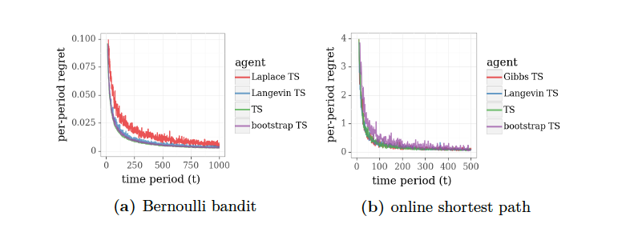
Approximate Bayes III - Bootstrapping
Bootstrapping was first considered in TS context in 2014 (Eckles and Kaptein)
Bootstrapping method refers to “resampling the sample”
Given the history of observed action-reward pairs, a
bootstrapped sample is constructed by sampling each component
uniformly at random.
Then the sampled parameter is obtained by solving the following optimization problem
(Random)

Slide 12
What else is Thompson’s Sampling Good for?
Incorporation of soft Prior Knowledge:
From the past data set, if we know ad1 is preferred over ad2 by the users, instead of uniform distribution, we can initialize TS with Beta(k₁, k₂)
where the parameters (k₁, k₂) may be obtained by curve-fitting.
Contextual Bandits:
In the OSP problem, suppose that the users have access to weather data, which affects travel time of routes differently.
In general, the reward distribution takes the form where
z_{t} denotes the context (e.g., weather report)
TS can be applied by augmenting the action to and taking
action from the restricted space

Slide 13
Variations of TS
Non-stationary systems:
The agent should never stop exploring if the parameters change with time
May be enforced by sampling from bounded history
Alternatively, we may directly perturb the posterior update equation to take into account non-stationarity as follows:
Regular TS update:
Perturbed TS update:
Concurrence:
Consider the OSP problem with multiple batches of agents travelling
At the end of each batch, the posterior distribution in TS is updated jointly
Agents benefit by shared observations (akin to collaborative filtering)

Slide 14
Performance of Thompson Sampling
Asymptotic Regret Bound for Bandits (Lai and Robbins, 1985):
Theorem 1 (Agrawal, Goyal 2012): For a two-armed bandit problem
the (instance dependent) regret of Thompson Sampling is bounded as
where
Theorem (Agrawal, Goyal 2013): Instance independent regret

Slide 15
Proof Sketch of Theorem 1
Sufficient to bound regret after the second arm has been played
L= times
If not, the regret is bounded by
After the second arm has been played L times, its Beta distribution of mean is tightly concentrated around
Hence, the first arm is played w.p. , where is
distributed as , given that the first arm has
been played j times with s(j) successes.
Number of steps between two successive plays of the first arm is Geometric with conditional expectation
For large j, using Chernoff bound, we have which, based on a Martingale argument, bounds the regret.

